Slide 1
CS6456: Graduate Operating Systems
Brad Campbell – bradjc@virginia.edu
https://www.cs.virginia.edu/~bjc8c/class/cs6456-f19/

Slide 2
Our Expectation with Data
Consider a single process using a filesystem
What do you expect to read?
Our expectation (as a user or a developer)
A read operation returns the most recent write.
This forms our basic expectation from any file or storage system.
Linearizability meets this basic expectation.
But it extends the expectation to handle multiple processes…
…and multiple replicas.
The strongest consistency model
P1
x.write(2)
x.read() ?

Slide 3
Expectation with Multiple Processes
What do you expect to read?
A single filesystem with multiple processes
Our expectation (as a user or a developer)
A read operation returns the most recent write, regardless of the clients.
We expect that a read operation returns the most recent write according to the single actual-time order.
In other words, read/write should behave as if there were a single (combined) client making all the requests.
It’s easiest to understand and program for a developer if your storage appears to process one request at a time.
P1
x.write(5)
P2
x.write(2)
x.read() ?

Slide 4
Expectation with Multiple Copies
What do you expect to read?
A single process with multiple servers with copies
Our expectation (as a user or a developer)
A read operation returns the most recent write, regardless of how many copies there are.
Read/write should behave as if there were a single copy.
P1
x.write(2)
x.read() ?

Slide 5
Linearizability
Three aspects
A read operation returns the most recent write,
…regardless of the clients,
…according to the single actual-time ordering of requests.
Or, put it differently, read/write should behave as if there were,
…a single client making all the (combined) requests in their original actual-time order (i.e., with a single stream of ops),
…over a single copy.
You can say that your storage system guarantees linearizability when it provides single-client, single-copy semantics where a read returns the most recent write.
It should appear to all clients that there is a single order (actual-time order) that your storage uses to process all requests.

Slide 6
Linearizability Exercise
Assume that the following happened with object x over a linearizable storage.
C1: x.write(A)
C2: x.write(B)
C3: x.read() → B, x.read() → A
C4: x.read() → B, x.read() → A
What would be an actual-time ordering of the events?
One possibility: C2 (write B) -> C3 (read B) -> C4 (read B) -> C1 (write A) -> C3 (read A) -> C4 (read A)
How about the following?
C1: x.write(A)
C2: x.write(B)
C3: x.read() → B, x.read() → A
C4: x.read() → A, x.read() → B

Slide 7
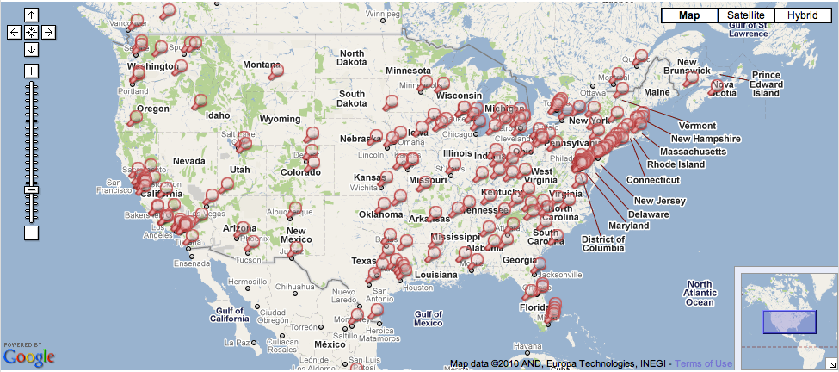

Linearizability Subtleties
Notice any problem with the representation?
You (NY)
x.write(5)
Friend (CA)
x.write(2)
read(x) ?
California
North Carolina

Slide 8
Linearizability Subtleties
A read/write operation is never a dot!
It takes time. Many things are involved, e.g., network, multiple disks, etc.
Read/write latency: the time measured right before the call and right after the call from the client making the call.
Clear-cut (e.g., black---write & red---read)
Not-so-clear-cut (parallel)
Case 1:
Case 2:
Case 3:

Slide 9
Linearizability Subtleties
With a single process and a single copy, can overlaps happen?
No, these are cases that do not arise with a single process and a single copy.
“Most recent write” becomes unclear when there are overlapping operations.
Thus, we (as a system designer) have freedom to impose an order.
As long as it appears to all clients that there is a single, interleaved ordering for all (overlapping and non-overlapping) operations that your implementation uses to process all requests, it’s fine.
I.e., this ordering should still provide the single-client, single-copy semantics.
Again, it’s all about how clients perceive the behavior of your system.

Slide 10
Linearizability Subtleties
Definite guarantee
Relaxed guarantee when overlap
Case 1
Case 2
Case 3

Slide 11
Linearizability Examples
Example 1: if your system behaves this way with 3 clients…
Example 2: if your system behaves this way with 3 clients…
a.write(x)
a.read() -> x
a.read() -> x
a.write(x)
If this were a.read() -> 0, would it support linearizability?
a.read() -> 0
a.read() -> x
a.read() -> x
No

Slide 12
Linearizability Examples
In example 2, what are the constraints?
Constraints (some ops don’t overlap)
a.read() → 0 happens before a.read() →x (you need to be able to explain why that happens that way).
a.read() → x happens before a.read() →x (you need to be able to explain why that happens that way).
The rest are up for grabs.
Scenario
Every client deals with a different copy of a.
a.write(x) gets propagated to (last client’s) a.read() -> x first.
a.write(x) gets propagated to (the second process’s) a.read() -> x, right after a.read() -> 0 is done.
a.write(x)
a.read() -> 0
a.read() -> x
a.read() -> x

Slide 13
Linearizability Examples
In example 2, why would a.read() return 0 and x when they’re overlapping?
This assumes that there’s a particular storage system that shows this behavior.
At some point between a read/write request sent and returned, the result becomes visible.
E.g., you read a value from physical storage, prepare it for return (e.g., putting it in a return packet, i.e., making it visible), and actually return it.
Or you actually write a value to a physical disk, making it visible (out of multiple disks, which might actually write at different points).
a.write(x)
a.read() -> 0
a.read() -> x
a.read() -> x

Slide 14

Linearizability Examples
Example 3
Constraints (ops that don’t overlap)
a.read() → x and a.read() → x: we cannot change these.
a.read() → y and a.read() → x: we cannot change these.
The rest is up for grabs.
a.write(x)
a.read() -> x
a.read() -> x
a.read() -> y
a.write(y)

Slide 15
Linearizability (Textbook Definition)
Let the sequence of read and update operations that client i performs in some execution be oi1, oi2,….
"Program order" for the client
A replicated shared object service is linearizable if for any execution (real), there is some interleaving of operations (virtual) issued by all clients that:
meets the specification of a single correct copy of objects
is consistent with the actual times at which each operation occurred during the execution
Main goal: any client will see (at any point of time) a copy of the object that is correct and consistent
The strongest form of consistency

Slide 16
Implementing Linearizability
Will this be difficult to implement?
It depends on what you want to provide.
How about:
All clients send all read/write to CA datacenter.
CA datacenter propagates to NC datacenter.
A request never returns until all propagation is done.
Correctness (linearizability)? yes
Performance? No
You (NY)
x.write(5)
Friend (CA)
x.write(2)
read(x) → 5

Slide 17
Implementing Linearizability
Importance of latency
Amazon: every 100ms of latency costs them 1% in sales.
Google: an extra .5 seconds in search page generation time dropped traffic by 20%.
Linearizability typically requires complete synchronization of multiple copies before a write operation returns.
So that any read over any copy can return the most recent write.
No room for asynchronous writes (i.e., a write operation returns before all updates are propagated.)
It makes less sense in a global setting.
Inter-datecenter latency: ~10s ms to ~100s ms
It might still makes sense in a local setting (e.g., within a single data center).

Slide 18
Relaxing the Guarantees
Linearizability advantages
It behaves as expected.
There’s really no surprise.
Application developers do not need any additional logic.
Linearizability disadvantages
It’s difficult to provide high-performance (low latency).
It might be more than what is necessary.
Relaxed consistency guarantees
Sequential consistency
Causal consistency
Eventual consistency
It is still all about client-side perception.
When a read occurs, what do you return?

Slide 19
Sequential Consistency
A little weaker than linearizability, but still quite strong
Essentially linearizability, except that it doesn’t need to return the most recent write according to physical time.
How can we achieve it?
Preserving the single-client, (per-process) single-copy semantics
We give an illusion that there’s a single copy to an isolated process.
The single-client semantics
Processing all requests as if they were coming from a single client (in a single stream of ops).
Again, this meets our basic expectation---it’s easiest to understand for an app developer if all requests appear to be processed one at a time.
Let’s consider the per-process single-copy semantics with a few examples.
Notes:
Think about facebook posts again.

Slide 20
Per-Process Single-Copy Semantics
Consider the following single process.
What do you expect to read?
3, not 2
Why even consider 2? E.g., if there were two copies not synchronized correctly, two writes could be applied to different copies.
Why 3 then?
It’s the program order.
Per-process single-copy semantics
When a storage system preserves a process’s program order, the process will believe that there’s a single copy.
P1
x.write(2)
x.read() → ?
x.write(3)

Slide 21
Per-Process Single-Copy Semantics
But we need to make it work with multiple processes.
When a storage system preserves each and every process’s program order, each will think that there’s a single copy.
Simple example
Per-process single-copy semantics
A storage system preserves each and every process’s program order.
It gives an illusion to every process that they’re working with a single copy.
P1
x.write(2)
x.read() → 3
x.write(3)
P2
x.read() → 5
x.write(5)
Notes:
Now the difference between linearizability and sequential consistency is delayed write visibility.

Slide 22
Pre-Process Single-Copy Examples
Example 1: Does this work like a single copy at P2?
Yes!
Does this satisfy linearizability?
Yes
P1
x.write(5)
P2
x.write(2)
x.write(3)
x.read() → 3
x.read() → 3

Slide 23
Pre-Process Single-Copy Examples
Example 2: Does this work like a single copy at P2?
Yes!
Does this satisfy linearizability?
No
It’s just that P1’s write is showing up later.
For P2, it’s like x.write(5) happens between the last two reads.
It’s also like P1 and P2’s operations are interleaved and processed like the arrow shows.
P1
x.write(5)
P2
x.write(2)
x.write(3)
x.read() → 3
x.read() → 5
Notes:
It’s like x.write(5) happens between x.read()->3 and x.read()->5.

Slide 24
Sequential Consistency
Insight: we don’t need to make other processes’ writes immediately visible.
Central question
Can you explain a storage system’s behavior by coming up with a single interleaving ordering of all requests, where the program order of each and every process is preserved?
Previous example:
We can explain this behavior by the following ordering of requests
x.write(2), x.write(3), x.read() → 3, x.write(5), x.read() → 5
P1
x.write(5)
P2
x.write(2)
x.write(3)
x.read() → 3
x.read() → 5

Slide 25
Sequential Consistency
Combining everything
Single-client semantics
Per-process single-copy semantics
Single-client semantics
All requests appear to come from a single client with a single interleaving of all requests.
I.e., all requests appear be processed one at a time.
Per-process single-copy semantics
In the single interleaving, the program order of each and every process is preserved.
This is delayed write visibility. In the single interleaving, all program orders are only logically preserved.

Slide 26
Sequential Consistency Examples
Example 1: Does this satisfy sequential consistency?
No: even if P1’s writes show up later, we can’t explain the last two writes.
P1
x.write(5)
x.write(3)
P2
x.write(2)
x.read() → 3
x.read() → 5

Slide 27
Sequential Consistency Examples
Example 2: Does this satisfy sequential consistency?
Yes
P1
x.write(2)
x.read() → 3
x.write(3)
P2
x.read() → 5
x.write(5)

Slide 28
Sequential Consistency Examples
Example 3
P1: a.write(A)
P2: a.write(B)
P3: a.read()->B a.read()->A
P4: a.read()->B a.read()->A
Example 4
P1: a.write(A)
P2: a.write(B)
P3: a.read()->B a.read()->A
P4: a.read()->A a.read()->B
Notes:
1: yes, 2: no

Slide 29
Sequential Consistency
Your storage appears to process all requests in a single interleaved ordering (single client), where…
…each and every process’s program order is preserved (single copy),
…and each process’s program order is only logically preserved, i.e., it doesn’t need to preserve its physical-time ordering.
It works as if all clients are reading out of a single copy.
This meets the expectation from an (isolated) client, working with a single copy.
Linearizability meets the expectation of all clients even if they all know what others are doing.
Both sequential consistency and linearizability provide an illusion of a single copy.

Slide 30
Sequential Consistency vs. Linearizability
Both should behave as if there were only a single copy, and a single client.
It’s just that SC doesn’t preserve the physical-time order, but just the program order of each client.
Difference
Linearizability: Once a write is returned, the system is obligated to make the result visible to all clients based on physical time. I.e., the system has to return 5 in the example.
Sequential consistency: Even if a write is returned, the system is not obligated to make the result visible to other clients immediately. I.e., the system can still return 2 in the example.
You (NY)
x.write(5)
Friend (CA)
x.write(2)
read(x) ?
Notes:
In sequential consistency, just like linearizability, synchronization needs to happen in the same order everywhere across different copies. Different from linearizability, that synchronization does not have to be complete at the time of return from a write operation.

Slide 31
Implementing Sequential Consistency
In what implementation would the following happen?
P1: a.write(A)
P2: a.write(B)
P3: a.read()->B a.read()->A
P4: a.read()->A a.read()->B
Possibility
P3 and P4 use different copies.
In P3’s copy, P2’s write arrives first and gets applied.
In P4’s copy, P1’s write arrives first and gets applied.
Writes are applied in different orders across copies.
This doesn’t provide sequential consistency.

Slide 32
Implementing Sequential Consistency
When implementing a consistency model, we need to think about how to handle writes and how to handle reads
Handling writes
Single-client, per-process single-copy: Write synchronization happens (or writes are applied) in the same order everywhere across different copies, while preserving each process’s logical write order.
The synchronization does not have to be complete at the time of return from a write operation. (I.e., actual writes on different copies can be done at different times.)
Handling reads
Single-client, per-process single-copy: A read from a process should be done on a copy that already has applied the process’s latest write. And all reads should be processed by the program order.

Slide 33
Implementing Sequential Consistency
Typical implementation
You’re not obligated to make the most recent write (according to physical time) visible (i.e., applied to all copies) right away.
But you are obligated to apply all writes in the same order for all copies.
What is this ordering guarantee?
FIFO-total.

Slide 34
Active Replication
Client
Front End
RM
….
RM
Client
Front End
RM
A front end FIFO-orders all reads and writes.
A read can be done completely with any single replica.
Writes are totally-ordered and asynchronous (after at least one write completes, it returns).
Total ordering doesn’t determine deliver times, i.e., writes can happen at different times at different replicas.
Sequential consistency, not linearizability
Read/write ops from the same client will be ordered at the front end (program order preservation).
Writes are applied in the same order by total ordering (single copy).
No guarantee that a read will read the most recent write based on actual time.
Notes:
What if we also totally-order reads? It provides linearizability at the cost of read performance.

Slide 35
Two More Consistency Models
Even more relaxed
We don’t even care about providing an illusion of a single copy.
Causal consistency
We care about ordering causally related write operations correctly.
Eventual consistency
As long as we can say all replicas converge to the same copy eventually, we’re fine.

Slide 36
Relaxing the Guarantees
For some applications, different clients (e.g., users) do not need to see the writes in the same order, but causality is still important (e.g., facebook post-like pairs).
Causal consistency
More relaxed than sequential consistency
Clients can read values out of order, i.e., it doesn’t behave as a single copy anymore.
Clients read values in-order for causally-related writes.
How do we define “causal relations” between two writes?
(Roughly) Client 0 writes → Client 1 reads → Client 1 writes
E.g., writing a comment on a post

Slide 37
Causal Consistency
Example 1:
Causally related
Concurrent writes
P1:
W(x)1
W(x) 3
P2:
R(x)1 W(x)2
P3:
R(x)1
R(x)3 R(x)2
P4:
R(x)1
R(x)2 R(x) 3
This sequence obeys causal consistency
Notes:
1 has to be read before 2 everywhere. Likewise, 1 has to be read before 3 everywhere. But not so for 2 and 3.

Slide 38
Causal Consistency Example 2
Causally consistent?
No!
Causally related
P1:
W(x)1
P2:
R(x)1 W(x)2
P3:
R(x)2 R(x)1
P4:
R(x)1 R(x) 2

Slide 39
Causal Consistency Example 3
Causally consistent?
Yes!
P1:
W(x)1
P2:
W(x)2
P3:
R(x)2 R(x)1
P4:
R(x)1 R(x) 2

Slide 40
Implementing Causal Consistency
We drop the notion of a single copy.
Writes can be applied in different orders across copies.
Causally-related writes do need to be applied in the same order for all copies.
Need a mechanism to keep track of causally-related writes.
Due to the relaxed requirements, low latency is more tractable.

Slide 41
Relaxing Even Further
Let’s just do best effort to make things consistent.
Eventual consistency
Popularized by the CAP theorem.
The main problem is network partitions.
Client + front end
Client + front end
Network
U
withdraw(B, 4)
T
partition
deposit(B,3);
B
Replica managers
B
B
B

Slide 42
Dilemma
In the presence of a network partition:
In order to keep the replicas consistent, you need to block.
From an outside observer, the system appears to be unavailable.
If we still serve the requests from two partitions, then the replicas will diverge.
The system is available, but no consistency.
The CAP theorem explains this dilemma.

Slide 43
Dealing with Network Partitions
During a partition, pairs of conflicting transactions may have been allowed to execute in different partitions. The only choice is to take corrective action after the network has recovered
Assumption: Partitions heal eventually
Abort one of the transactions after the partition has healed
Basic idea: allow operations to continue in one or some of the partitions, but reconcile the differences later after partitions have healed

Slide 44
Quorum Approaches
Quorum approaches used to decide whether reads and writes are allowed
There are two types: pessimistic quorums and optimistic quorums
In the pessimistic quorum philosophy, updates are allowed only in a partition that has the majority of RMs
Updates are then propagated to the other RMs when the partition is repaired.

Slide 45
Static Quorums
The decision about how many RMs should be involved in an operation on replicated data is called Quorum selection
Quorum rules state that:
At least r replicas must be accessed for read
At least w replicas must be accessed for write
r + w > N, where N is the number of replicas
w > N/2
Each object has a version number or a consistent timestamp

Slide 46
Static Quorums
r = 2, w = 2, N = 3: r + w > N, w > N/2
N0
N1
N2
Client 1: Write
Client 2: Read

Slide 47
Static Quorums
What does r + w > N mean?
The only way to satisfy this condition is that there’s always an overlap between the reader set and the write set.
There’s always some replica that has the most recent write.
What does w > N/2 mean?
When there’s a network partition, only the partition with more than half of the RMs can perform write operations.
The rest will just serve reads with stale data.
R and W are tunable:
E.g., N=3, r=1, w=3: High read throughput, perhaps at the cost of write throughput.

Slide 48
Optimistic Quorum Approaches
An Optimistic Quorum selection allows writes to proceed in any partition.
“Write, but don’t commit”
Unless the partition gets healed in time.
Resolve write-write conflicts after the partition heals.
Optimistic Quorum is practical when:
Conflicting updates are rare
Conflicts are always detectable
Damage from conflicts can be easily confined
Repair of damaged data is possible or an update can be discarded without consequences
Partitions are relatively short-lived

Slide 49
Lamport Clocks

Slide 50
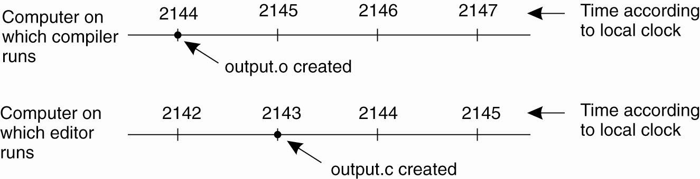
A distributed edit-compile workflow
Physical time →
2143 < 2144 ➔ make doesn’t call compiler
Lack of time synchronization result – a possible object file mismatch

Slide 51
What makes time synchronization hard?
Quartz oscillator sensitive to temperature, age, vibration, radiation
Accuracy ca. one part per million (one second of clock drift over 12 days)
The internet is:
Asynchronous: arbitrary message delays
Best-effort: messages don’t always arrive

Slide 52
Just use Coordinated Universal Time?
UTC is broadcast from radio stations on land and satellite (e.g., the Global Positioning System)
Computers with receivers can synchronize their clocks with these timing signals
Signals from land-based stations are accurate to about 0.1−10 milliseconds
Signals from GPS are accurate to about one microsecond
Why can’t we put GPS receivers on all our computers?

Slide 53


Synchronization to a time server
Suppose a server with an accurate clock (e.g., GPS-disciplined crystal oscillator)
Could simply issue an RPC to obtain the time:
But this doesn’t account for network latency
Message delays will have outdated server’s answer
Client
Server
Time of day?
2:50 PM
Time ↓

Slide 54
Cristian’s algorithm: Outline
Client sends a request packet, timestamped with its local clock T₁
Server timestamps its receipt of the request T₂ with its local clock
Server sends a response packet with its local clock T₃ and T₂
Client locally timestamps its receipt of the server’s response T₄
Client
Server
T₁
request:
T₁
T₂
T₃
T₄
T₂,T₃
response:
How the client can use these timestamps to synchronize its local clock to the server’s local clock?
Time ↓

Slide 55
Cristian’s algorithm: Offset sample calculation
Client
Server
Goal: Client sets clock ← T₃ + 𝛿_{resp}
Client samples round trip time 𝛿 = 𝛿_{req} + 𝛿_{resp} = (T₄ − T₁) − (T₃ − T₂)
But client knows 𝛿, not 𝛿_{resp}
T₁
request:
T₁
𝛿_{req}
T₂
𝛿_{resp}
T₃
Assume: 𝛿_{req} ≈ 𝛿_{resp}
T₄
T₂,T₃
response:
Client sets clock ← T₃ + ½𝛿
Time ↓

Slide 56
Berkeley algorithm
A single time server can fail, blocking timekeeping
The Berkeley algorithm is a distributed algorithm for timekeeping
Assumes all machines have equally-accurate local clocks
Obtains average from participating computers and synchronizes clocks to that average

Slide 57
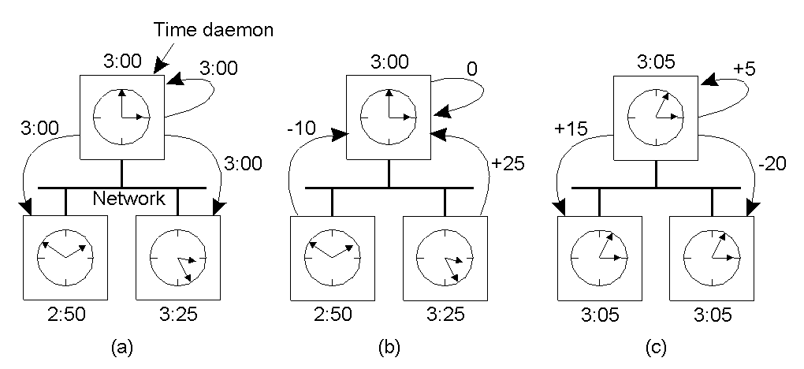
Berkeley algorithm
Master machine: polls L other machines using Cristian’s algorithm → { 𝜃_{i} } (i = 1…L)
Master

Slide 58
The Network Time Protocol (NTP)
Enables clients to be accurately synchronized to UTC despite message delays
Provides reliable service
Survives lengthy losses of connectivity
Communicates over redundant network paths
Provides an accurate service
Unlike the Berkeley algorithm, leverages heterogeneous accuracy in clocks

Slide 59
NTP: System structure
Servers and time sources are arranged in layers (strata)
Stratum 0: High-precision time sources themselves
e.g., atomic clocks, shortwave radio time receivers
Stratum 1: NTP servers directly connected to Stratum 0
Stratum 2: NTP servers that synchronize with Stratum 1
Stratum 2 servers are clients of Stratum 1 servers
Stratum 3: NTP servers that synchronize with Stratum 2
Stratum 3 servers are clients of Stratum 2 servers
Users’ computers synchronize with Stratum 3 servers

Slide 60
NTP operation: Server selection
Messages between an NTP client and server are exchanged in pairs: request and response
Use Cristian’s algorithm
For i^{th} message exchange with a particular server, calculate:
Clock offset 𝜃_{i} from client to server
Round trip time 𝛿_{i} between client and server
Over last eight exchanges with server k, the client computes its dispersion 𝜎_{k} = max_{i} 𝛿_{i} − min_{i} 𝛿_{i}
Client uses the server with minimum dispersion

Slide 61
NTP operation : Clock offset calculation
Client tracks minimum round trip time and associated offset over the last eight message exchanges (𝛿₀, 𝜃₀)
𝜃₀ is the best estimate of offset: client adjusts its clock by 𝜃₀ to synchronize to server
Offset 𝜃
Each point represents one sample
𝜃₀
𝛿₀
Round trip time 𝛿

Slide 62
NTP operation: How to change time
Can’t just change time: Don’t want time to run backwards
Recall the make example
Instead, change the update rate for the clock
Changes time in a more gradual fashion
Prevents inconsistent local timestamps

Slide 63
Clock synchronization: Take-away points
Clocks on different systems will always behave differently
Disagreement between machines can result in undesirable behavior
NTP, Berkeley clock synchronization
Rely on timestamps to estimate network delays
100s 𝝁s−ms accuracy
Clocks never exactly synchronized
Often inadequate for distributed systems
Often need to reason about the order of events
Might need precision on the order of ns

Slide 64
Motivation: Multi-site database replication
A New York-based bank wants to make its transaction ledger database resilient to whole-site failures
Replicate the database, keep one copy in sf, one in nyc
San Francisco
New York

Slide 65
The consequences of concurrent updates
Replicate the database, keep one copy in sf, one in nyc
Client sends query to the nearest copy
Client sends update to both copies
“Deposit
$100”
Inconsistent replicas!
Updates should have been performed in the same order at each copy
$1,000
$1,000
$1,010
$1,100
$1,110
$1,111
“Pay 1%
interest”

Slide 66
Idea: Logical clocks
Landmark 1978 paper by Leslie Lamport
Insight: only the events themselves matter
Idea: Disregard the precise clock time
Instead, capture just a “happens before” relationship between a pair of events

Slide 67
Defining “happens-before”
Consider three processes: P1, P2, and P3
Notation: Event a happens before event b (a → b)
P1
P2
P3
Physical time ↓

Slide 68
Defining “happens-before”
Can observe event order at a single process
P1
P2
P3
a
b
Physical time ↓

Slide 69
Defining “happens-before”
If same process and a occurs before b, then a → b
P1
P2
P3
a
b
Physical time ↓

Slide 70
Defining “happens-before”
If same process and a occurs before b, then a → b
Can observe ordering when processes communicate
P1
P2
P3
a
b
c
Physical time ↓

Slide 71
Defining “happens-before”
If same process and a occurs before b, then a → b
If c is a message receipt of b, then b → c
P1
P2
P3
a
b
c
Physical time ↓

Slide 72
Defining “happens-before”
If same process and a occurs before b, then a → b
If c is a message receipt of b, then b → c
Can observe ordering transitively
P1
P2
P3
a
b
c
Physical time ↓

Slide 73
Defining “happens-before”
If same process and a occurs before b, then a → b
If c is a message receipt of b, then b → c
If a → b and b → c, then a → c
P1
P2
P3
a
b
c
Physical time ↓

Slide 74
Concurrent events
Not all events are related by →
a, d not related by → so concurrent, written as a || d
P1
P2
P3
a
d
b
c
Physical time ↓

Slide 75
Lamport clocks: Objective
We seek a clock time C(a) for every event a
Clock condition: If a → b, then C(a) < C(b)
Plan: Tag events with clock times; use clock times to make distributed system correct

Slide 76
The Lamport Clock algorithm
Each process P_{i} maintains a local clock C_{i}
Before executing an event, C_{i} ← C_{i} + 1
P1
C₁=0
P2
C₂=0
P3
C₃=0
a
b
c
Physical time ↓

Slide 77
The Lamport Clock algorithm
Before executing an event a, C_{i} ← C_{i} + 1:
Set event time C(a) ← C_{i}
P1
C₁=1
P2
C₂=1
P3
C₃=1
C(a) = 1
a
b
c
Physical time ↓

Slide 78
The Lamport Clock algorithm
Before executing an event b, C_{i} ← C_{i} + 1:
Set event time C(b) ← C_{i}
P1
C₁=2
P2
C₂=1
P3
C₃=1
C(a) = 1
a
C(b) = 2
b
c
Physical time ↓

Slide 79
The Lamport Clock algorithm
Before executing an event b, C_{i} ← C_{i} + 1
Send the local clock in the message m
P1
C₁=2
P2
C₂=1
P3
C₃=1
C(a) = 1
a
C(b) = 2
b
c
Physical time ↓
C(m) = 2

Slide 80
The Lamport Clock algorithm
On process P_{j} receiving a message m:
Set C_{j} and receive event time C(c) ←1 + max{ C_{j}, C(m) }
P1
C₁=2
P2
C₂=3
P3
C₃=1
C(a) = 1
a
C(b) = 2
C(c) = 3
b
c
Physical time ↓
C(m) = 2

Slide 81
Ordering all events
Break ties by appending the process number to each event:
Process P_{i} timestamps event e with C_{i}(e).i
C(a).i < C(b).j when:
C(a) < C(b), or C(a) = C(b) and i < j
Now, for any two events a and b, C(a) < C(b) or C(b) < C(a)
This is called a total ordering of events

Slide 82
Making concurrent updates consistent
P2
P1
Recall multi-site database replication:
San Francisco (P1) deposited $100:
New York (P2) paid 1% interest:
$
%
We reached an inconsistent state
Could we design a system that uses Lamport Clock total order to make multi-site updates consistent?

Slide 83
Totally-Ordered Multicast
Client sends update to one replica → Lamport timestamp C(x)
Key idea: Place events into a local queue
Sorted by increasing C(x)
P1’s local
queue:
1.1
1.2
P2’s local
queue:
1.2
$
%
%
P1
P2
Goal: All sites apply the updates in (the same) Lamport clock order

Slide 84
Totally-Ordered Multicast ^{(Almost correct)}
On receiving an event from client, broadcast to others (including yourself)
On receiving an event from replica:
Add it to your local queue
Broadcast an acknowledgement message to every process (including yourself)
On receiving an acknowledgement:
Mark corresponding event acknowledged in your queue
Remove and process events everyone has ack’ed from head of queue

Slide 85
Totally-Ordered Multicast (Almost correct)
1.1
P1 queues $, P2 queues %
P1 queues and ack’s %
P1 marks % fully ack’ed
P2 marks % fully ack’ed
1.1
1.2
1.2
%
$
%
$
✔
✔
✔
✔
P2
P1
1.1
1.2
$
%
ack
%
%
P2 processes %
(Ack’s to self not shown here)

Slide 86
Totally-Ordered Multicast ^{(Correct version)}
On receiving an event from client, broadcast to others (including yourself)
On receiving or processing an event:
Add it to your local queue
Broadcast an acknowledgement message to every process (including yourself) only from head of queue
When you receive an acknowledgement:
Mark corresponding event acknowledged in your queue
Remove and process events everyone has ack’ed from head of queue

Slide 87
Totally-Ordered Multicast ^{(Correct version)}
1.1
1.2
1.1
1.2
$
%
$
%
✔
✔
✔
✔
P2
P1
1.1
1.2
$
%
ack
$
$
$
ack
%
%
%
(Ack’s to self not shown here)

Slide 88
So, are we done?
Does totally-ordered multicast solve the problem of multi-site replication in general?
Not by a long shot!
Our protocol assumed:
No node failures
No message loss
No message corruption
All to all communication does not scale
Waits forever for message delays (performance?)

Slide 89
Take-away points: Lamport clocks
Can totally-order events in a distributed system: that’s useful!
But: while by construction, a → b implies C(a) < C(b),
The converse is not necessarily true:
C(a) < C(b) does not imply a → b (possibly, a || b)
Can’t use Lamport clock timestamps to infer causal relationships between events

Slide 90
Vector clock (VC)
Label each event e with a vector V(e) = [c₁, c₂ …, c_{n}]
c_{i} is a count of events in process i that causally precede e
Initially, all vectors are [0, 0, …, 0]
Two update rules:
For each local event on process i, increment local entry c_{i}
If process j receives message with vector [d₁, d₂, …, d_{n}]:
Set each local entry c_{k} = max{c_{k}, d_{k}}
Increment local entry c_{j}

Slide 91
Vector clock: Example
All counters start at [0, 0, 0]
Applying local update rule
Applying message rule
Local vector clock piggybacks on inter-process messages
P1
P2
P3
a
[1,0,0]
e
[0,0,1]
[2,0,0]
b
[2,0,0]
[2,1,0]
c
[2,2,0]
d
[2,2,0]
[2,2,2]
f
Physical time ↓

Slide 92
Vector clocks can establish causality
Rule for comparing vector clocks:
V(a) = V(b) when a_{k} = b_{k} for all k
V(a) < V(b) when a_{k} ≤ b_{k} for all k and V(a) ≠ V(b)
Concurrency: a || b if a_{i} < b_{i} and a_{j} > b_{j}, some i, j
V(a) < V(z) when there is a chain of events linked by → between a and z
a
[1,0,0]
[2,0,0]
b
[2,1,0]
c
z
[2,2,0]

Slide 93
Two events a, z
Lamport clocks: C(a) < C(z)
Conclusion: None
Vector clocks: V(a) < V(z)
Conclusion: a → … → z
Vector clock timestamps tell us about causal event relationships

Slide 94
VC application: Causally-ordered bulletin board system
Distributed bulletin board application
Each post → multicast of the post to all other users
Want: No user to see a reply before the corresponding original message post
Deliver message only after all messages that causally precede it have been delivered
Otherwise, the user would see a reply to a message they could not find

Slide 95
VC application: Causally-ordered bulletin board system
Original
post
1’s reply
Physical time →
User 0 posts, user 1 replies to 0’s post; user 2 observes

Slide 96
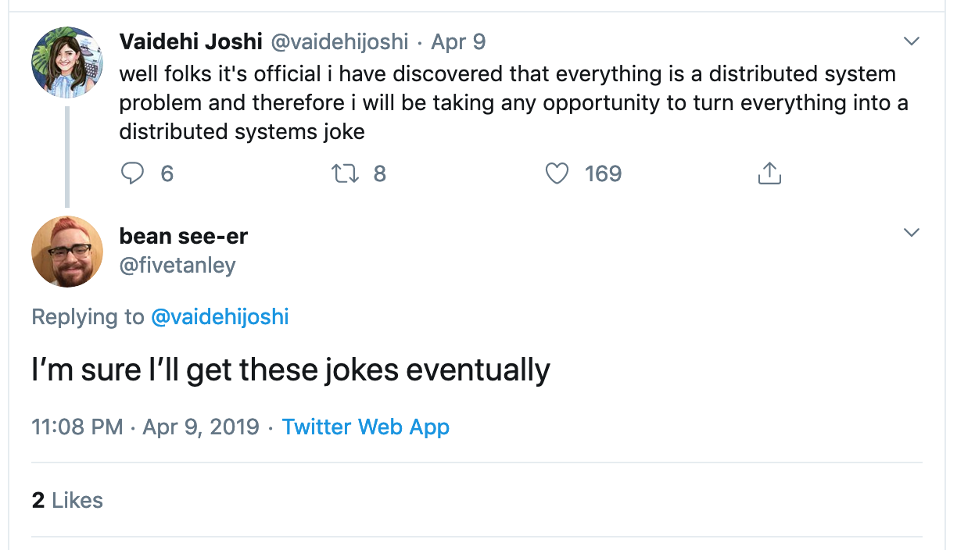

Slide 97
Distributing data

Slide 98
Scaling out: Place and partition
Problem 1: Data placement
On which node(s) to place a partition?
Maintain mapping from data object to responsible node(s)
Problem 2: Partition management
Including how to recover from node failure
e.g., bringing another node into partition group
Changes in system size, i.e. nodes joining/leaving
Centralized: Cluster manager
Decentralized: Deterministic hashing and algorithms

Slide 99
Modulo hashing
Consider problem of data partition:
Given object id X, choose one of k servers to use
Suppose instead we use modulo hashing:
Place X on server i = hash(X) mod k
What happens if a server fails or joins (k ← k±1)?
or different clients have different estimate of k?

Slide 100
Problem for modulo hashing: Changing number of servers
h(x) = x + 1 (mod 4)
Add one machine: h(x) = x + 1 (mod 5)
Server
4
3
All entries get remapped to new nodes!
→ Need to move objects over the network
2
1
0
5
7
10
11
27
29
36
38
40
Object serial number

Slide 101
Consistent hashing
Assign n tokens to random points on mod 2^{k} circle; hash key size = k
Hash object to random circle position
Put object in closest clockwise bucket
successor (key) → bucket
0
14
Token
12
4
Bucket
8
Desired features –
Balance: No bucket has “too many” objects
Smoothness: Addition/removal of token minimizes object movements for other buckets

Slide 102
Consistent hashing’s load balancing problem
Each node owns 1/n^{th} of the ID space in expectation
Says nothing of request load per bucket
If a node fails, its successor takes over bucket
Smoothness goal ✔: Only localized shift, not O(n)
But now successor owns two buckets: 2/n^{th} of key space
The failure has upset the load balance

Slide 103
Virtual nodes
Idea: Each physical node implements v virtual nodes
Each physical node maintains v > 1 token ids
Each token id corresponds to a virtual node
Each virtual node owns an expected 1/(vn)^{th} of ID space
Upon a physical node’s failure, v virtual nodes fail
Their successors take over 1/(vn)^{th} more
Result: Better load balance with larger v

Slide 104
Dynamo: The P2P context
Chord and DHash intended for wide-area P2P systems
Individual nodes at Internet’s edge, file sharing
Central challenges: low-latency key lookup with small forwarding state per node
Techniques:
Consistent hashing to map keys to nodes
Replication at successors for availability under failure

Slide 105
Dynamo

Slide 106

Amazon’s workload (in 2007)
Tens of thousands of servers in globally-distributed data centers
Peak load: Tens of millions of customers
Tiered service-oriented architecture
Stateless web page rendering servers, atop
Stateless aggregator servers, atop
Stateful data stores (e.g. Dynamo)
put( ), get( ): values “usually less than 1 MB”

Slide 107
How does Amazon use Dynamo?
Shopping cart
Session info
Maybe “recently visited products” et c.?
Product list
Mostly read-only, replication for high read throughput

Slide 108
Dynamo requirements
Highly available writes despite failures
Despite disks failing, network routes flapping, “data centers destroyed by tornadoes”
Always respond quickly, even during failures → replication
Low request-response latency: focus on 99.9% SLA
Incrementally scalable as servers grow to workload
Adding “nodes” should be seamless
Comprehensible conflict resolution
High availability in above sense implies conflicts

Slide 109
Design questions
How is data placed and replicated?
How are requests routed and handled in a replicated system?
How to cope with temporary and permanent node failures?

Slide 110
Dynamo’s system interface
Basic interface is a key-value store
get(k) and put(k, v)
Keys and values opaque to Dynamo
get(key) → value, context
Returns one value or multiple conflicting values
Context describes version(s) of value(s)
put(key, context, value) → “OK”
Context indicates which versions this version supersedes or merges

Slide 111
Dynamo’s techniques
Place replicated data on nodes with consistent hashing
Maintain consistency of replicated data with vector clocks
Eventual consistency for replicated data: prioritize success and low latency of writes over reads
And availability over consistency (unlike DBs)
Efficiently synchronize replicas using Merkle trees
Key trade-offs: Response time vs. consistency vs. durability

Slide 112
Data placement
Key K
put(K,…), get(K) requests go to me
Coordinator node
Each data item is replicated at N virtual nodes (e.g., N = 3)

Slide 113
Data replication
Much like in Chord: a key-value pair → key’s N successors (preference list)
Coordinator receives a put for some key
Coordinator then replicates data onto nodes in the key’s preference list
Preference list size > N to account for node failures
For robustness, the preference list skips tokens to ensure distinct physical nodes

Slide 114
Gossip and “lookup”
Gossip: Once per second, each node contacts a randomly chosen other node
They exchange their lists of known nodes (including virtual node IDs)
Each node learns which others handle all key ranges
Result: All nodes can send directly to any key’s coordinator (“zero-hop DHT”)
Reduces variability in response times

Slide 115
Partitions force a choice between availability and consistency
Suppose three replicas are partitioned into two and one
If one replica fixed as master, no client in other partition can write
In Paxos-based primary-backup, no client in the partition of one can write
Traditional distributed databases emphasize consistency over availability when there are partitions

Slide 116
Dynamo provides eventual consistency
Dynamo emphasizes availability over consistency when there are partitions
Tell client write complete when only some replicas have stored it
Propagate to other replicas in background
Allows writes in both partitions…but risks:
Returning stale data
Write conflicts when partition heals:
put(k,v₀)
put(k,v₁)
?@%$!!

Slide 117
Mechanism: Sloppy quorums
If no failure, reap consistency benefits of single master
Else sacrifice consistency to allow progress
Dynamo tries to store all values put() under a key on first N live nodes of coordinator’s preference list
BUT to speed up get() and put():
Coordinator returns “success” for put when W < N replicas have completed write
Coordinator returns “success” for get when R < N replicas have completed read

Slide 118
Sloppy quorums: Hinted handoff
Suppose coordinator doesn’t receive W replies when replicating a put()
Could return failure, but remember goal of high availability for writes…
Hinted handoff: Coordinator tries further nodes in preference list (beyond first N) if necessary
Indicates the intended replica node to recipient
Recipient will periodically try to forward to the intended replica node

Slide 119
Hinted handoff: Example
Suppose C fails
Node E is in preference list
Needs to receive replica of the data
Hinted Handoff: replica at E points to node C
When C comes back
E forwards the replicated data back to C
Key K
Coordinator

Slide 120
Wide-area replication
Last ¶,§4.6: Preference lists always contain nodes from more than one data center
Consequence: Data likely to survive failure of entire data center
Blocking on writes to a remote data center would incur unacceptably high latency
Compromise: W < N, eventual consistency

Slide 121
Sloppy quorums and get()s
Suppose coordinator doesn’t receive R replies when processing a get()
Penultimate ¶,§4.5: “R is the min. number of nodes that must participate in a successful read operation.”
Sounds like these get()s fail
Why not return whatever data was found, though?
As we will see, consistency not guaranteed anyway…

Slide 122
Sloppy quorums and freshness
Common case given in paper: N = 3; R = W = 2
With these values, do sloppy quorums guarantee a get() sees all prior put()s?
If no failures, yes:
Two writers saw each put()
Two readers responded to each get()
Write and read quorums must overlap!

Slide 123
Sloppy quorums and freshness
Common case given in paper: N = 3, R = W = 2
With these values, do sloppy quorums guarantee a get() sees all prior put()s?
With node failures, no:
Two nodes in preference list go down
put() replicated outside preference list
Two nodes in preference list come back up
get() occurs before they receive prior put()

Slide 124
Conflicts
Suppose N = 3, W = R = 2, nodes are named A, B, C
1st put(k, …) completes on A and B
2nd put(k, …) completes on B and C
Now get(k) arrives, completes first at A and C
Conflicting results from A and C
Each has seen a different put(k, …)
Dynamo returns both results; what does client do now?

Slide 125
Conflicts vs. applications
Shopping cart:
Could take union of two shopping carts
What if second put() was result of user deleting item from cart stored in first put()?
Result: “resurrection” of deleted item
Can we do better? Can Dynamo resolve cases when multiple values are found?
Sometimes. If it can’t, application must do so.

Slide 126
Version vectors (vector clocks)
Version vector: List of (coordinator node, counter) pairs
e.g., [(A, 1), (B, 3), …]
Dynamo stores a version vector with each stored key-value pair
Idea: track “ancestor-descendant” relationship between different versions of data stored under the same key k

Slide 127
Version vectors: Dynamo’s mechanism
Rule: If vector clock comparison of v1 < v2, then the first is an ancestor of the second – Dynamo can forget v1
Each time a put() occurs, Dynamo increments the counter in the V.V. for the coordinator node
Each time a get() occurs, Dynamo returns the V.V. for the value(s) returned (in the “context”)
Then users must supply that context to put()s that modify the same key

Slide 128
Version vectors (auto-resolving case)
put handled by node A
v1 [(A,1)]
put handled by node C
v2 [(A,1), (C,1)]
v2 > v1, so Dynamo nodes automatically drop v1, for v2

Slide 129
Version vectors (app-resolving case)
put handled by node A
v1 [(A,1)]
put handled by node B
put handled by node C
v2 [(A,1), (B,1)]
v3 [(A,1), (C,1)]
v2 || v3, so a client must perform semantic reconciliation
Client reads v2, v3; context: [(A,1), (B,1), (C,1)]
v4 [(A,2), (B,1), (C,1)]
Client reconciles v2 and v3; node A handles the put

Slide 130
Trimming version vectors
Many nodes may process a series of put()s to same key
Version vectors may get long – do they grow forever?
No, there is a clock truncation scheme
Dynamo stores time of modification with each V.V. entry
When V.V. > 10 nodes long, V.V. drops the timestamp of the node that least recently processed that key

Slide 131
Impact of deleting a VV entry?
put handled by node A
v1 [(A,1)]
put handled by node C
v2 [(A,1), (C,1)]
v2 || v1, so looks like application resolution is required

Slide 132
Concurrent writes
What if two clients concurrently write w/o failure?
e.g. add different items to same cart at same time
Each does get-modify-put
They both see the same initial version
And they both send put() to same coordinator
Will coordinator create two versions with conflicting VVs?
We want that outcome, otherwise one was thrown away
Paper doesn't say, but coordinator could detect problem via put() context

Slide 133
Removing threats to durability
Hinted handoff node crashes before it can replicate data to node in preference list
Need another way to ensure that each key-value pair is replicated N times
Mechanism: replica synchronization
Nodes nearby on ring periodically gossip
Compare the (k, v) pairs they hold
Copy any missing keys the other has
How to compare and copy replica state quickly and efficiently?

Slide 134
Efficient synchronization with Merkle trees
Merkle trees hierarchically summarize the key-value pairs a node holds
One Merkle tree for each virtual node key range
Leaf node = hash of one key’s value
Internal node = hash of concatenation of children
Compare roots; if match, values match
If they don’t match, compare children
Iterate this process down the tree

Slide 135
Merkle tree reconciliation
B is missing orange key; A is missing green one
Exchange and compare hash nodes from root downwards, pruning when hashes match
A’s values:
B’s values:
[0, 2¹²⁸)
[0, 2¹²⁸)
[0, 2¹²⁷)
[2¹²⁷, 2¹²⁸)
[0, 2¹²⁷)
[2¹²⁷, 2¹²⁸)
Finds differing keys quickly and with minimum information exchange

Slide 136
How useful is it to vary N, R, W?
N | R | W | Behavior
3 | 2 | 2 | Parameters from paper: Good durability, good R/W latency
3 | 3 | 1 | Slow reads, weak durability, fast writes
3 | 1 | 3 | Slow writes, strong durability, fast reads
3 | 3 | 3 | More likely that reads see all prior writes?
3 | 1 | 1 | Read quorum doesn’t overlap write quorum

Slide 137
Dynamo: Take-away ideas
Consistent hashing broadly useful for replication—not only in P2P systems
Extreme emphasis on availability and low latency, unusually, at the cost of some inconsistency
Eventual consistency lets writes and reads return quickly, even when partitions and failures
Version vectors allow some conflicts to be resolved automatically; others left to application

Slide 138
Design Questions
What type of reconciliation policies are possible? What applications would be conducive to dealing with potential conflicts?
What would happen if an application using Dynamo was very read-heavy (i.e. keys were rarely written to, but very frequently read)? An example might be photo storage.

